Slide 1








NEUROFLEETX: AI-POWERED URBAN FLEET AND TRAFFIC INTELLIGENCE
By Anurag Tiwari

Slide 2
PROJECT OVERVIEW
What is NeurofleetX? AI-based system for optimizing urban fleet and traffic.
Goal: To use data and AI to make city transportation smarter, more efficient, and less congested.
Key Features:
Secure User Login and Registration
User-specific Dashboard (for fleet management insights)
User Authentication

Slide 3
PROBLEM STATEMENT
- Cities face traffic congestion, pollution, and accidents.
- Fleet operators struggle with high fuel costs, delays, and poor route planning.
- Traditional traffic systems are not adaptive or smart.

Slide 4
PROJECT ANALYSIS
Problem Statement:
Urban Challenges: Cities worldwide face increasing traffic congestion, pollution, and operational inefficiencies in fleet management.
Inefficient Systems: Existing systems lack real-time data analysis and intelligent optimization capabilities, leading to wasted time and resources.
Proposed Solution:
AI-Powered Optimization: Use AI and machine learning to predict traffic and find the most efficient routes, saving time and fuel.
Real-time Intelligence: Analyze live data to provide accurate traffic insights, enabling fleet managers to make better, faster decisions.
Scalability: Build a system that can manage everything from a small fleet to an entire city's traffic network.

Slide 5
PROJECT OBJECTIVES
- Optimize fleet operations using AI.
- Analyze and predict traffic patterns in real-time.
- Reduce congestion, fuel usage, and emissions.
- Improve safety and efficiency in urban mobility.

Slide 6
BENEFITS
✅ Reduced traffic congestion
✅ Lower fuel & operational costs
✅ Fewer accidents
✅ Time saving for commuters
✅ Cleaner and greener cities

Slide 7
TECH STACK
Frontend:
HTML5: For structuring the web pages.
CSS3: For styling and design.
JavaScript: For interactive elements and front-end logic.
Backend (Full Stack - Java):
Java (Spring Boot): The core framework for building the backend logic, handling API endpoints, and user authentication.
MySQL / MongoDB: For storing user data, fleet information, and other project-related data.
REST APIs: For communication between the frontend and backend

Slide 8
HOW THE PROJECT WILL BE BUILT - PHASE 1 (FOUNDATION)
Step 1: Frontend Development:
Design and create the user interface (UI) for the home, login, registration, and dashboard pages.
Focus on a clean, responsive, and intuitive design.
Step 2: Backend & Database Setup:
Use Spring Boot to create the backend.
Set up a database (e.g., MySQL) to store user credentials securely.
Create user authentication and registration APIs.
Step 3: Connecting Frontend and Backend:
Use JavaScript to send user data from the frontend forms to the backend APIs.
Handle user sessions to ensure the dashboard is accessible only after a successful login.

Slide 9
HOW THE PROJECT WILL BE BUILT - PHASE 2 (CORE INTELLIGENCE)
Step 1: Data Integration:
Set up systems to collect real-time data from vehicles (GPS data) and traffic sensors.
Step 2: AI/ML Model Development:
Build AI models using Python (for ML) and integrate them with the backend using APIs.
Create a model for route optimization to find the most efficient paths.
Develop a model for traffic prediction to forecast congestion.
Step 3: Real-time Dashboard & Visualization:
Build an interactive dashboard that uses the processed data from the AI models.
Use a library like Leaflet.js or Google Maps API to visualize real-time vehicle locations and traffic flow.

Slide 10
CHALLENGES FACED (CHALLENGES FACED WHILE BUILDING THE INITIAL PROTOTYPE)
Challenge 1: Frontend Design: Discuss the process of designing the user interface to be clean and intuitive. (like, "Starting with a simple, minimalist design to ensure a clean user experience.")
Challenge 2: User Authentication Logic: Explain the complexity of building a secure and functional login/registration system. (Like, "Implementing secure password hashing and session management was a key technical challenge.")
Challenge 3: Integrating Different Pages: Mention how you linked the different pages (Home, Login, Dashboard, Register) to ensure smooth navigation. (Like, "Ensuring a seamless flow from login to the secure dashboard was crucial.")

Slide 11
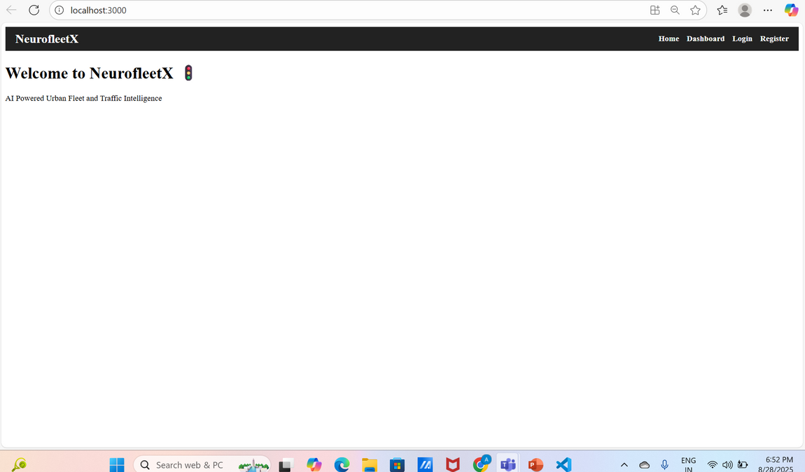
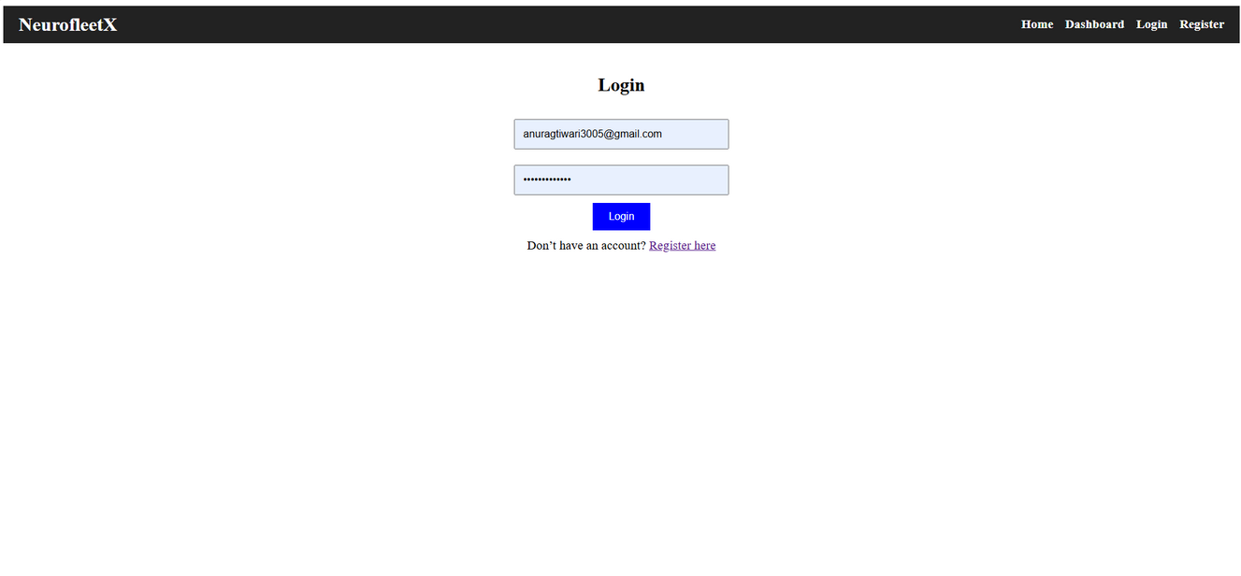
SCREENSHOTS OF THE CURRENT PROTOTYPE
Home Page:"The welcome page of NeurofleetX."
Login Page : "User login portal with validation."

Slide 12
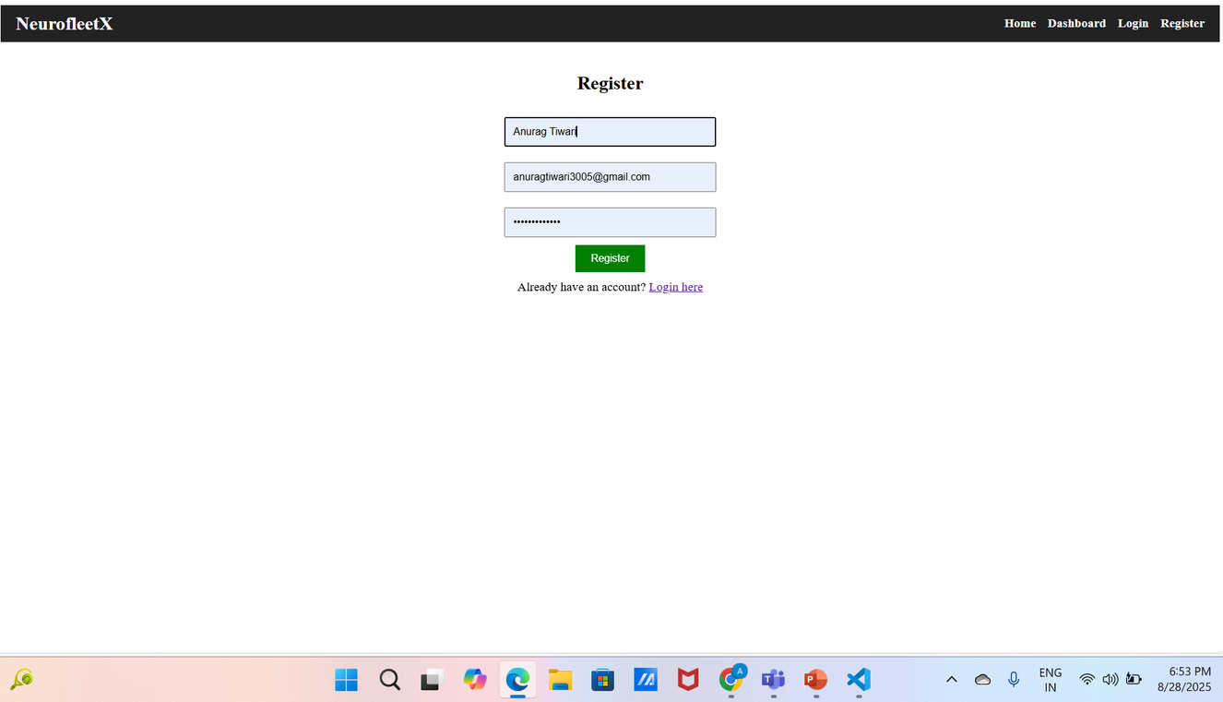
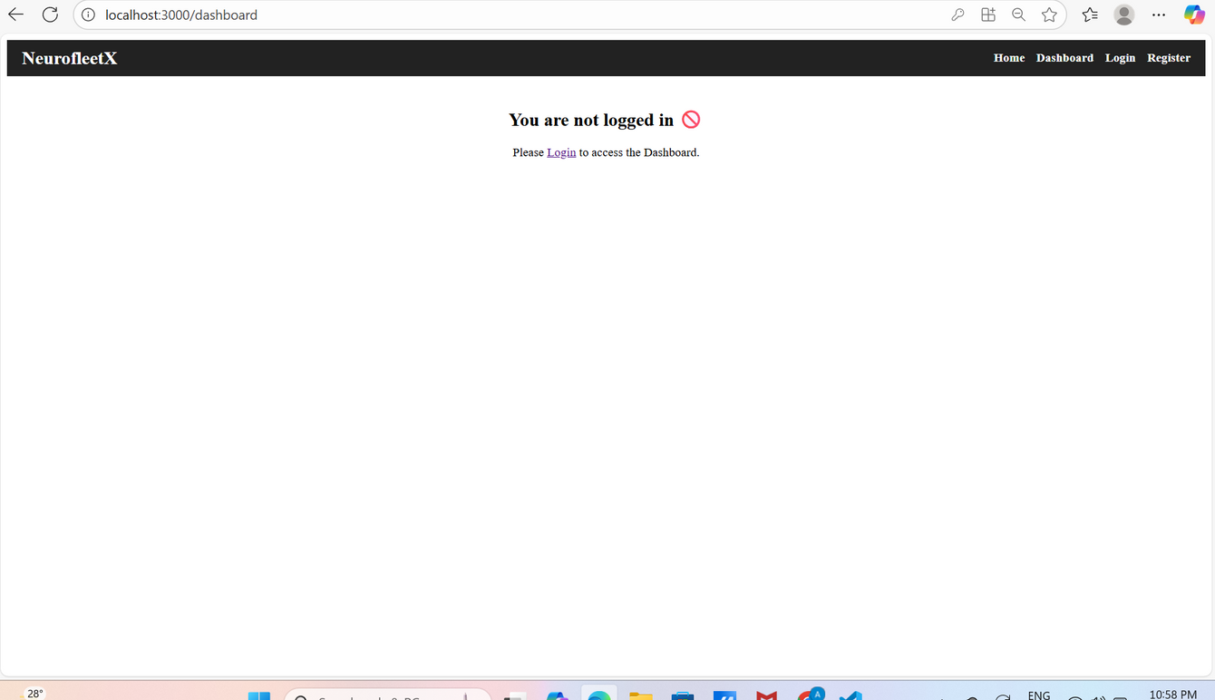
Registration Page: "New user registration."
Dashboard Access Control: "Secured dashboard access, visible only after successful login."

Slide 13
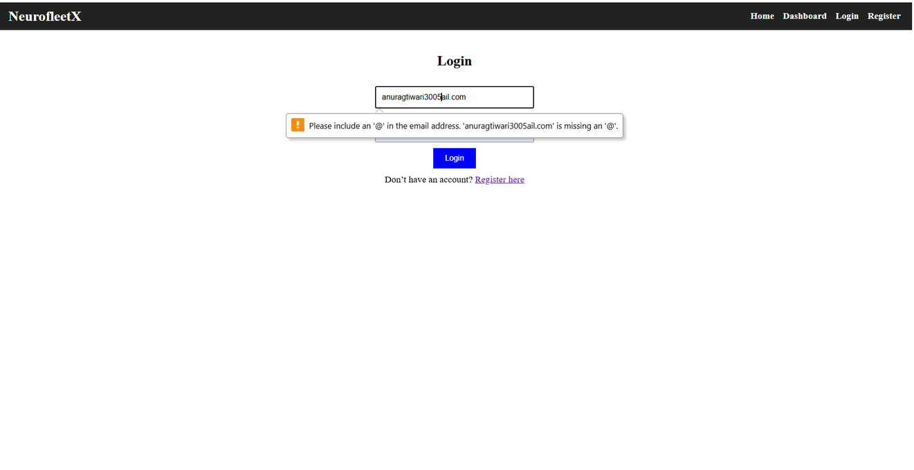
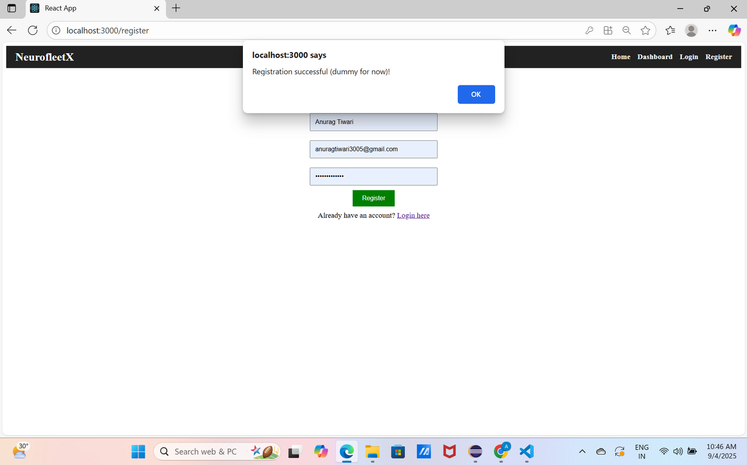
Login Validation Error: "Error handling for invalid input."
Submission Confirmation: "Submission confirmation page."

Slide 14
NEXT STEPS (FUTURE ROADMAP)
Step 1: Backend Development: Connecting the current frontend to a database for user authentication.
Step 2: AI & ML Integration: Developing and integrating models for fleet route optimization, traffic prediction, and real-time data analysis.
Step 3: Real-time Data Visualization: Building interactive maps and dashboards to display live data from the fleet.
Step 4: API Development: Creating an API for third-party services to access the system's intelligence.

Slide 15
THANK YOU

